Slide 1
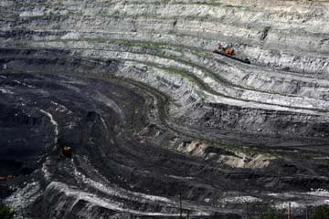
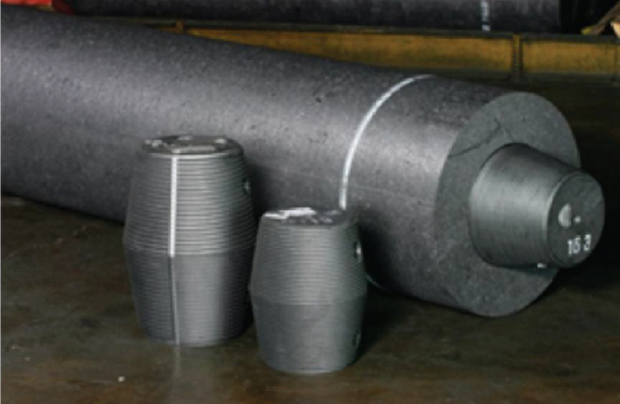
Non fuel use of coal 7th RTC on coal Hotel Le Meridien, New Delhi 24th September, 2019
Tarit Baran Das
Chief Scientist
CSIR-Central Mining and Fuel Research Institute
Dhanbad

Slide 2
India’s Energy Outlook
Indian economy is one of the fastest growing major economies of the world.
India is the 3rd largest energy consumer in the world, but ranks 47th in terms of per capita energy consumption.
Coal dominates India's energy consumption matrix accounting for 56% of primary energy consumption.
India has committed reduction of emission intensity of its GDP by 33–35% by 2030 from 2005 level to combat climate change.
India targets to achieve renewable energy capacity of 175 GW by 2022 and 40 percent of installed capacity from non-fossil fuel based energy resources by 2030.

Slide 3
Role of coal in India
Coal, an important economic sector in India providing direct job to around 5,00,000 peoples and indirect about 20,00,000 peoples.
Central Electricity Authority has estimated that an additional coal-based capacity of 44 GW will be required during 2022–27.
India has initiated one ‘carbon capture, utilization and storage’ (CCUS) project. Carbion Clean Solutions (CCSL), based in Chennai, is currently generating power at a small plant on a commercial basis, while capturing about 97 per cent of its carbon emissions.

Slide 4
Role of coal in India
Government has implemented the Perform Achieve and Trade (PAT) scheme which aims to improve energy efficiency of large industrial consumer such as iron and steel, cement and power generation. India’s energy efficiency in large industrial facilities is already close to world class.
Coal will contribute 42% of total energy supply in 2047.
Thrust on Clean coal: Indian government has promoted plant efficiency in the country’s coal fleet, closing older subcritical stations and building or upgrading the fleet to supercritical or ultra-supercritical High Efficiency Low Emissions (HELE) technologies.

Slide 5
Factors influencing coal use
Environmental concerns will have the greatest influence on future coal use:
Stringent environmental regulations restricting emissions of CO2, SOx, NOx, particulates and air toxics,
Disposal of large volume of solid wastes
Possible penalties for CO2 emissions
Methane from coal mining is also of concern as a greenhouse gas.

Slide 6
Coal conversion to produce clean products and fuels is the answer to sustainable use of coal
Predominant direct uses of coal
Power, steel, cement, chemicals production
Aluminum refinery, paper, non ferrous metal industry
Non fuel use of coal
Coal-to-chemicals through processing of coal tar
Coal gasification & coal liquefaction
Carbon based materials from coal feed stock

Slide 7
Various Coal Transformation Routes

Slide 8
Products from coal gasification and liquefaction to oil and chemicals

Slide 9
Conclusion
Traditional source of coal chemicals, tars or liquids from by-product coke ovens, has steadily decreased in the last decades.
Opportunities are increasing for new applications and markets for coal chemicals, and carbon-based materials.
Projected global decline of coal electricity generation will make available more coal for non fuel use.

Slide 10
Thank you!

